Slide 1
Safety and Efficacy of Long-Acting CAB and RPV as Two Drug IM Maintenance Therapy: LATTE-2 Week 96 Results
J Eron,¹ D Margolis,² J Gonzalez-Garcia,³ H-J Stellbrink,⁴ Y Yazdanpanah,⁵ D Podzamczer,⁶ T Lutz,⁷ JB Angel,⁸ GJ Richmond,⁹ B Clotet,¹⁰ F Gutierrez,¹¹ L Sloan,¹² KC Sutton,² D Dorey,¹³ KY Smith,² PE Williams,¹⁴ WR Spreen²
¹University of North Carolina at Chapel Hill, Division of Infectious Diseases, Chapel Hill, NC, USA; ²ViiV Healthcare, Research Triangle Park, NC, USA; ³Hospital Universitario La Paz/IdiPAZ, Madrid, Spain; ⁴ICHHamburg, Hamburg, Germany; ⁵Hôpital Bichat Claude Bernard, Paris, France; ⁶Hospital Universitari de Bellvitge-IDIBELL, Barcelona, Spain; ⁷Infektiologikum, Frankfurt, Germany; ⁸The Ottawa Hospital, Ottawa, ON, Canada; ⁹Broward General Medical Center, Fort Lauderdale, FL, USA; ¹⁰Hospital Germans Trias i Pujol, UAB, UVICUCC, Badalona, Spain; ¹¹Hospital General de Elche & Universidad Miguel Hernández, Alicante, Spain; ¹²North Texas Infectious Disease Consultants, Dallas, TX, USA; ¹³GlaxoSmithKline, Mississauga, ON, Canada; ¹⁴Janssen Research and Development, Beerse, Belgium

Slide 2
Disclosures
Dr. Joseph Eron has received research grants from GlaxoSmithKline, ViiV Healthcare, Gilead Sciences, and Janssen awarded to his institution
Dr. Eron has served as a consultant to ViiV Healthcare, Gilead Sciences, Merck, and Janssen
Eron et al. IAS 2017; Paris, France. Slides MOAX0205LB.

Slide 3
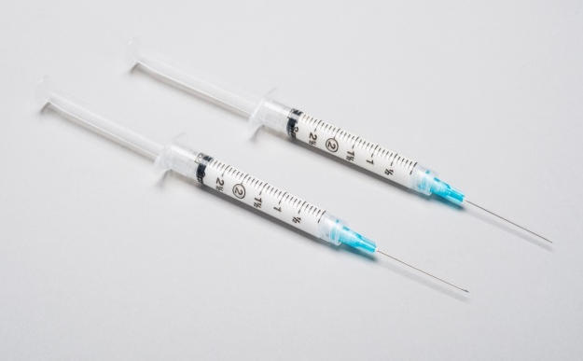
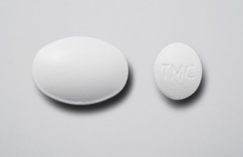
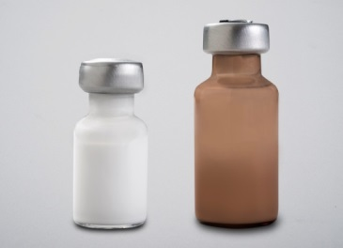
Background
Cabotegravir (CAB) is an HIV-1 integrase inhibitor
Oral 30 mg tablet (t_{½}, ~40 hours)
IM LA injection 200 mg/mL (t_{½}, ~20-40 days)
Rilpivirine (RPV) is an HIV-1 NNRTI
Oral 25 mg tablet (t_{½}, ~50 hours)
IM LA injection 300 mg/mL (t_{½}, ~30-90 days)
Oral 2-drug CAB + RPV proof of efficacy established through Week 144 in LATTE¹
LATTE-2 Week 48 data supported the decision to evaluate the Q4W CAB LA + RPV LA IM regimen in phase III studies (ongoing)
Q8W dosing remains under long-term evaluation within LATTE-2
CAB, cabotegravir; IM, intramuscular; LA, long acting; NNRTI, non-nucleoside reverse transcriptase inhibitor; Q4W, every 4 weeks; Q8W, every 8 weeks; RPV, rilpivirine; t_{½}, half-life.
1. Margolis et al. Lancet Infect Dis. 2015;15:1145-1155. (CROI 2017)
Eron et al. IAS 2017; Paris, France. Slides MOAX0205LB.

Slide 4
LATTE-2 Objectives
Establish proof of principle for the first ever long-acting (LA) injectable HIV treatment regimen
Primary objectives
Evaluate the safety and efficacy of CAB LA + RPV LA as maintenance therapy
Select a dosing schedule of CAB LA + RPV LA for progression into phase III studies
Key secondary objectives
Characterize pharmacokinetics of CAB LA and RPV LA
Evaluate the tolerability and acceptability of IM dosing
CAB, cabotegravir; IM, intramuscular; LA, long acting; NNRTI, RPV, rilpivirine; t_{½}, half-life.
Eron et al. IAS 2017; Paris, France. Slides MOAX0205LB.

Slide 5
LATTE-2 Study Design
Induction period
Maintenance periodª
Inclusion criteria | ≥18 years old Naive to antiretroviral therapy CD4+ ≥200 cells/mm³
Exclusion criteria | Positive for hepatitis B ALT ≥5 × ULN Creatinine clearance <50 mL/min
Qualification for maintenance | HIV-1 RNA <50 c/mL between Week -4 and Day 1
CAB 400 mg IM + RPV 600 mg IM
Q4W (n=115)
CAB loading dose at Day 1 (800 mg)
CAB 30 mg + ABC/3TC PO QD for 20 weeks
(N=309)
CAB 600 mg IM + RPV 900 mg IM
Q8W (n=115)
CAB 30 mg + ABC/3TC for 20 weeks
CAB loading doses at Day 1 (800 mg) and Week 4 (600 mg)
CAB 30 mg + ABC/3TC PO QD (n=56)
Add RPV PO QD
4 weeks
Day 1 Randomization
2:2:1
Week 32 Primary analysis Dosing regimen selection
Week 48 Analysis Dosing regimen confirmation
Week 96^{b}
ABC/3TC, abacavir/lamivudine; ALT, alanine aminotransferase; IM, intramuscular; PO, orally; QD, once daily; Q4W, every 4 weeks; Q8W, every 8 weeks; ULN, upper limit of normal. ªSubjects who withdrew after at least 1 IM dose entered the long-term follow-up period. ^{b}Subjects can elect to enter Q4W and Q8W LA extension phase beyond Week 96.
Eron et al. IAS 2017; Paris, France. Slides MOAX0205LB.
Notes:
Talk through mg and volume of injection

Slide 6
Baseline Characteristics ITT-ME Population*
 | Q8W IM (n=115) | Q4W IM (n=115) | Oral CAB (n=56) | Total (N=286)
Median age, years | 35 | 36 | 35 | 35
Female, n (%) | 8 (7) | 6 (5) | 10 (18) | 24 (8)
African American/African heritage, n (%) | 17 (15) | 12 (10) | 15 (27) | 44 (15)
CDC class C, n (%) | 1 (<1) | 2 (2) | 0 | 3 (1)
HIV-1 RNA, median, log₁₀ c/mL | 4.4 | 4.5 | 4.3 | 4.4
≥100,000 c/mL, n (%) | 16 (14) | 28 (24) | 7 (12) | 51 (18)
CD4+ cell count, median, cells/mm³ | 449 | 499 | 518 | 489
*Randomized population following 20-week oral induction period (286/309).
CAB, cabotegravir; CDC, Centers for Disease Control and Prevention; IM, intramuscular; ITT-ME, intent-to-treat maintenance exposed; Q4W, every 4 weeks; Q8W, every 8 weeks.
Eron et al. IAS 2017; Paris, France. Slides MOAX0205LB.
Notes:
State here – across 309 subjects who entered the induction phase of the study – 286 qualified for and entered maintenance to constitute the maintenance population

Slide 7
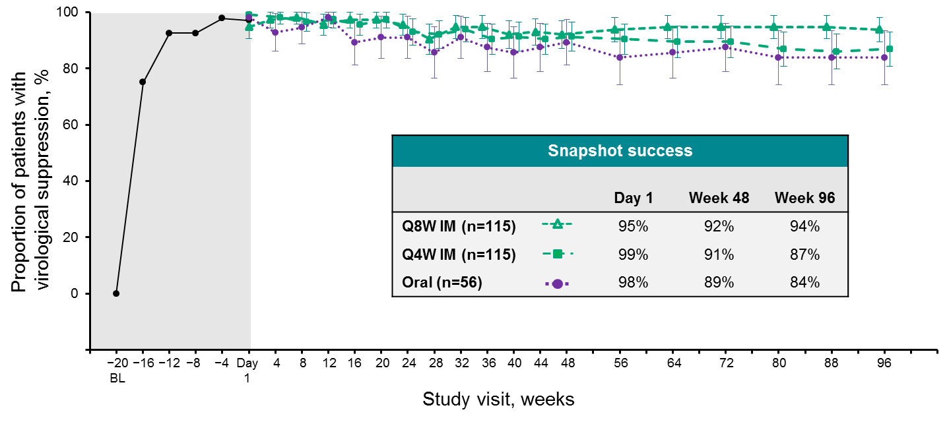
LATTE-2 Week 96 Results HIV-1 RNA <50 c/mL by Snapshot (ITT-ME)
Oral CAB induction period (ITT-ME population)
Maintenance period
BL, baseline; CAB, cabotegravir; ITT-ME, intent-to-treat maintenance exposed; Q4W, every 4 weeks; Q8W, every 8 weeks.
Eron et al. IAS 2017; Paris, France. Slides MOAX0205LB.

Slide 8
Comparable Response Across Arms Week 96 HIV-1 RNA <50 c/mL by Snapshot (ITT-ME)
Virologic outcomes
Treatment differences (95% CI)
Oral
IM
Q8W IM
− 0.6%
20.5%
Q4W IM
−8.4%
14.4%
CAB, cabotegravir; CI, confidence interval; IM, intramuscular; ITT-ME, intent-to-treat maintenance exposed; LA, long acting; NRTI, nucleoside reverse transcriptase inhibitor; PO, orally; Q4W, every 4 weeks; Q8W, every 8 weeks; RPV, rilpivirine.
Eron et al. IAS 2017; Paris, France. Slides MOAX0205LB.

Slide 9
Snapshot Outcomes HIV-1 RNA <50 c/mL at Week 96 (ITT-ME)
Week 96 outcomes, n (%) | Q8W IM (n=115) | Q4W IM (n=115) | Oral CAB (n=56)
Virologic response | 108 (94) | 100 (87) | 47 (84)
Virologic nonresponse | 5 (4) | 0 | 1 (2)
Data in window not <50 c/mLª | 2 (2) | 0 | 0
Discontinued for lack of efficacy | 1 (<1) | 0 | 1 (2)
Discontinued for other reason while not <50 c/mL | 2 (2) ^{b} | 0 | 0
No virologic data in window | 2 (2) | 15 (13) | 8 (14)
Discontinued due to adverse event or death | 1 (<1) | 9 (8) | 2 (4)
Discontinued for other reasons | 1 (<1) | 5 (4) | 6 (11)
Missing data during window but on study | 0 | 1 (<1) | 0
ªWeek 96 HIV-1 RNA, 87 copies per mL, 118 copies per mL. ^{b}Includes one subject who withdrew consent because of injection tolerability.
IM, intramuscular; ITT-ME, intent-to-treat maintenance exposed; Q4W, every 4 weeks; Q8W, every 8 weeks.
Eron et al. IAS 2017; Paris, France. Slides MOAX0205LB.

Slide 10
LATTE-2 Week 96 Q4W Arm: Snapshot No Data in Window Category
Snapshot sub-reason = Discontinued due to AE or death
Subject | DC visit | AE term | Max grade | Drug related | Serious | AE leading to DC
1 | Week 12 | Rash (torso) | 3 | Y | N | Y
2 | Week 16 | Liver stopping criteria | -- | -- | -- | N
3 | Week 72 | QT prolongation Sinus tachycardia | 3 2 | Y Y | N N | Y Y
4 | Week 32 | Churg-Strauss vasculitis | 3 | N | Y | Y
5 | Week 44 | Hepatitis C | 2 | N | N | Y
6 | Week 48 | Mesenteric vein thrombosis | 2 | N | Y | Y
7 | Week 32 | Epilepsy | 4 | N | Y | Y
8 | Week 24 | Depression | 3 | Y | N | Y
9 | Week 20 | Psychosis | 3 | Y | N | Y
Snapshot sub-reason = Discontinued for other reasons while <50 c/mL
Subject | DC visit | Primary reason | Sub-reason
10 | Week 40 | Withdrawal by subject | Subject relocated
11 | Week 80 | Withdrawal by subject | Subject relocated
12 | Week 12 | Protocol deviation | Prohibited medication use
13 | Week 20 | Protocol deviation | Pregnancy
14 | Week 64 | Withdrawal by subject | Frequency of visits
Snapshot sub-reason = Missing data during window but on study
Subject | Week 88 | Week 96 | Week 100 |  | Week104
15 | <40 c/mL | Missing | <40 c/mL |  | <40 c/mL
AE, adverse event; DC, discontinuation.
Eron et al. IAS 2017; Paris, France. Slides MOAX0205LB.

Slide 11
Protocol-Defined Virologic Failure (PDVF)ª ITT-ME
Through 96 Weeks
2 PDVFs Q8W
1 without treatment emergent resistance (Week 4)^{b}
1 with INI + NNRTI mutations (Week 48)^{c}
No PDVFs Q4W
1 PDVF Oral CAB + NRTIs (Week 8)
No treatment emergent resistance
No additional PDVFs occurred after Week 48 in any arm
CAB, cabotegravir; FC, fold change; INI, integrase inhibitor; ITT-ME, intent-to-treat maintenance exposed; NRTI, nucleoside reverse transcriptase inhibitor; NNRTI, non-nucleoside reverse transcriptase inhibitor; PDVF, protocol-defined virologic failure; Q4W, every 4 weeks; Q8W, every 8 weeks; RPV, rilpivirine. ªPDVF: <1.0 log₁₀ c/mL decrease in plasma HIV-1 RNA by Week 4, OR confirmed HIV-1 RNA ≥200 c/mL after prior suppression to <200 c/mL, OR >0.5 log₁₀ c/mL increase from nadir HIV-1 RNA value ≥200 c/mL. ^{b}No detectable RPV at Week 4 and Week 8, suggesting maladministration at Day 1. ^{c}NNRTI—K103N, E138G, and K238T (FC RPV=3.3; etravirine=1.9); INI—Q148R (FC CAB=5.1; dolutegravir=1.38).
Eron et al. IAS 2017; Paris, France. Slides MOAX0205LB.

Slide 12
Adverse Events and Labs Week 96 Maintenance Period
ITT-ME population, n (%) | Q8W IM (n=115) | Q4W IM (n=115) | Oral CAB (n=56) | IM subtotal (N=230)
Drug-related AEs, excluding ISRs (≥3%)
Pyrexia | 4 (3) | 7 (6) | 0 | 11 (5)
Headache | 3 (3) | 3 (3) | 2 (4) | 6 (3)
Influenza-like illness | 3 (3) | 3 (3) | 0 | 6 (3)
Fatigue | 2 (2) | 3 (3) | 1 (2) | 5 (2)
Grade 3 and 4 AEs, excluding ISRs | 13 (11) | 18 (16) | 4 (7) | 31 (13)
Drug-related grade 3/4 AEs, excluding ISRsª | 2 (2) | 5 (4) | 1 (2) | 7 (3)
Serious AEs (none drug related) | 11 (10) | 11 (10) ^{b} | 7 (13) | 22 (10)
AEs leading to withdrawal | 2 (2) | 8 (7) | 1 (2) | 10 (4)
Grade 3 and 4 labs^{c} | 22 (19) | 33(29) | 12 (21) | 55 (24)
AE, adverse event; CAB, cabotegravir; IM, intramuscular; ITT-ME, intent-to-treat maintenance exposed; ISR, injection-site reaction; Q4W, every 4 weeks; Q8W, every 8 weeks.
ªQ8W: influenza-like illness, chills, and pain; Q4W: influenza-like illness, rash, depression, QT prolongation, and psychosis. ^{b}One death (epilepsy). ^{c}Maintenance emergent.
Eron et al. IAS 2017; Paris, France. Slides MOAX0205LB.

Slide 13
ISRs for CAB LA or RPV LA Over Time
Overall ISR AE incidence
Bars represent incidence of onset ISR events relative to the most recent IM injection visit.
Day 4 8 12 16 20 24 28 32 36 40 44 48 52 56 60 64 68 72 76 80 84 88 92 96 1
Subjects at visit
Study visit, weeks
Q8W IM 115 115 114 — 113 — 112 — 112 — 111 — 111 — 110 — 110 — 109 — 109 — 110 — 109
Q4W IM 115 115 115 114 112 111 109 109 107 107 105 105 104 104 104 104 102 103 103 102 99 100 101 101 101
99% of ISR events were mild (84%) or moderate (15%), and 89% resolved within 7 days
Most common ISR events: pain (66%), nodules (8%), swelling (6%), and pruritus (6%)
2 of 230 subjects (<1%) had an ISR that led to discontinuation (Q8W) through Week 96
AE, adverse event; CAB, cabotegravir; IM, intramuscular; ISR, injection-site reaction; LA, long acting; Q4W, every 4 weeks; Q8W, every 8 weeks; RPV, rilpivirine.
Eron et al. IAS 2017; Paris, France. Slides MOAX0205LB.

Slide 14
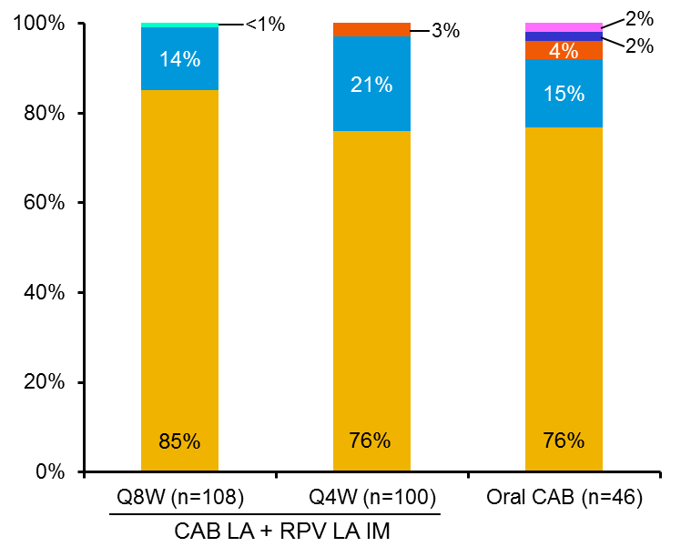
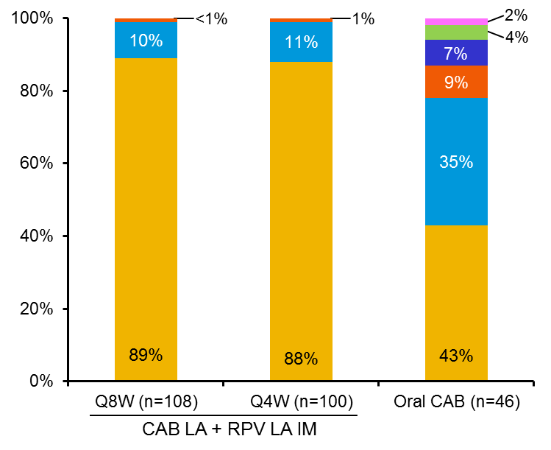
Patient-Reported Outcomes at Week 96 Maintenance Treatmentª
How satisfied are you with your current treatment?
How satisfied would you be to continue with your present form of treatment?
6 5 4 3 2 1 0
Very satisfied
Very dissatisfied
CAB, cabotegravir; IM, intramuscular; LA, long acting; Q4W, every 4 weeks; Q8W, every 8 weeks; RPV, rilpivirine. ªBased on observed case data set of subjects who completed HIV Treatment Satisfaction Questionnaire status version at Week 96.
Eron et al. IAS 2017; Paris, France. Slides MOAX0205LB.

Slide 15
Conclusions LATTE-2 96-Week Results
IM CAB LA + RPV LA, dosed every 4 or 8 weeks, successfully maintained HIV-1 viral load <50 c/mL
2 participants on LA dosing met PDVF criteria, no participants after Week 48
Injection tolerability
Majority of ISRs were grade 1 to 2 pain, with a median duration of 3 days
<1% of participants had an ISR that led to discontinuation
High overall patient-reported satisfaction
Dose selection
Q4W dosing selected and under evaluation in 2 pivotal phase III studies
Week 96 data demonstrate long-term durability of both Q4W and Q8W dosing options
Q8W dosing to be evaluated in upcoming phase III study
Manuscript is being published in The Lancet today, July 24, 2017
CAB, cabotegravir; IM, intramuscular; LA, long acting; Q4W, every 4 weeks; Q8W, every 8 weeks; RPV, rilpivirine.
Eron et al. IAS 2017; Paris, France. Slides MOAX0205LB.

Slide 16
Acknowledgments
We thank everyone who has contributed to the success of the study
All study participants and their families
The ViiV Healthcare, GlaxoSmithKline, PAREXEL, and Janssen study team members
The LATTE-2 clinical investigators and their staffs in Spain, Germany, France, Canada, and the United States
LATTE-2 was funded by ViiV Healthcare and Janssen R&D
The study team wishes to express sincere condolences to the family, friends, and patients of Dr. Louis Sloan, co-author and long-term HIV researcher who passed away during the conduct of LATTE-2
Canada Angel Baril Charest Conway de Pokomandy Kasper LeBlanc Smith | France Bouchaud Durant Girard Khuong-Josses Livrozet Pialoux Poizot-Martin Raffi Yazdanpanah | Germany Arasteh Baumgarten Degen Jaeger Lutz Rockstroh Schuermann Stellbrink Stoll | Spain Berenguer Blanco Arévalo Clotet Sala del Mar Gutierrez González García Gutierrez Rodero Hernández-Mora Podzamczer Palter Pulido Ortega | United States Bettacchi Bhatti Brinson De Vente Eron Felizarta Hagins Henry Mills Overton Ramgopal Richmond Rybak Scott Swindells
Eron et al. IAS 2017; Paris, France. Slides MOAX0205LB.

Slide 17
Backup
Eron et al. IAS 2017; Paris, France. Slides MOAX0205LB.

Slide 18
LATTE-2 Week 96 AEs Leading to Withdrawal
Subj | AE term(s) | Max grade | Drug related? | Serious?
Q8W
1 | Injection-site pain Injection-site pruritus Chills and body pain | 2 1 3 | Y Y Y | N N N
2ª | Injection-site pain/induration/swelling | 2 | Y | N
Q4W
3 | Rash (torso) | 3 | Y | N
4 | Churg-Strauss vasculitis | 3 | N | Y
5 | Hepatitis C | 2 | N | N
6 | Epilepsy | 4 | N | Y
7 | Depression | 3 | Y | N
8 | Mesenteric vein thrombosis | 2 | N | Y
9 | Psychosis | 3 | Y | N
10^{b} | QT prolongation Sinus tachycardia | 3 2 | Y Y | N N
Oral
11 | Acute hepatitis | 2 | N | N
Note: 2 additional subjects had discontinuation due to liver safety stopping criteria (Q4W, 1 subject at Week 16; Oral, 1 subject at Week 32).
AE, adverse event; DC, discontinuation; Q4W, every 4 weeks; Q8W, every 8 weeks. ªPrimary reason for discontinuation for subject 2 was intolerability of injections rather than adverse event. ^{b}Reported after Week 48.
Eron et al. IAS 2017; Paris, France. Slides MOAX0205LB.

Slide 19
LATTE-2 Week 96 Q8W Arm: Snapshot No Data in Window Category
Snapshot sub-reason = Discontinued due to AE or death
Subject | Visit of discontinuation | AE term | Max grade |  | Drug related | Serious | AE leading to DC
1 | Week 24 | ISR | Grade 2 |  | Y | N | Y
 |  | chills/body pain | Grade 3 |  | Y | N | Y
Snapshot sub-reason = Discontinued for other reasons while <50 c/mL
Subject | Visit of discontinuation | Primary reason |  | Sub-reason
2 | Week 48 | Withdrawal by subject |  | Other: patient early withdrawal
AE, adverse event; DC, discontinuation; Q8W, every 8 weeks.
Eron et al. IAS 2017; Paris, France. Slides MOAX0205LB.

Slide 20
LATTE-2 Week 96 Oral CAB Arm: Snapshot No Data in Window Category
Snapshot sub-reason = Discontinued due to AE or death
Subject | Visit of Discontinuation | AE Term | Max Grade |  | Drug Rel. | Serious | AE leading to DC
1 | Week 36 | Acute Hepatitis | 2 |  | N | N | Y
2 | Week 36 | Liver Stopping Criteria | - |  | - | - | N
Snapshot sub-reason = Discontinued for other reasons while < 50 c/mL
Subject | Visit of discontinuation | Primary reason |  | Sub-reason
3 | Week 56 | Withdrawal by subject |  | Other: subject has increased meth addiction and unable to comply with visits.
4 | Week 28 | Withdrawal by subject |  | Other: doesn’t want to take tablets, wanted injections within this study
5 | Week 80 | Withdrawal by subject |  | Other: patient wants to be pregnant
6* | Week 96 | Withdrawal by subject |  | Subject relocated
7 | Week 24 | Lost to follow-up
8 | Week 8 | Withdrawal by subject |  | Subject relocated
* Subject discontinued IP after Week 72 and did not return until a follow-up visit at Week 96.
AE, adverse event; DC, discontinuation; Q8W, every 8 weeks.
Eron et al. IAS 2017; Paris, France. Slides MOAX0205LB.

Slide 21
Injection-Site Reactions— Maintenance Period
 | Q8W IM (n=115) | Q4W IM (n=115) | IM subtotal (N=230)
Number of injections | 3160 | 5419 | 8579
Number of ISR events | 1925 | 2435 | 4360
Grades, n (%)
Grade 1 events | 1543 (80) | 2105 (86) | 3648 (84)
Grade 2 events | 359 (19) | 314 (13) | 673 (15)
Grade 3 events | 16 (<1) | 14 (<1) | 30 (<1)
Grade 4 events | 0 | 0 | 0
Duration
≤7, n (%) | 1718 (89) | 2172 (89) | 3890 (89)
Median, days | 3.0 | 3.0 | 3.0
IM, intramuscular; ISR, injection-site reaction; Q4W, every 4 weeks; Q8W, every 8 weeks.
Eron et al. IAS 2017; Paris, France. Slides MOAX0205LB.

Slide 22
Week 48 Pharmacokinetics
Cabotegravir
Rilpivirine
PA-IC₉₀
PA-IC₉₀
Both Q4W and Q8W steady state exposures approximate once-daily oral dosing
Dosing schedule for Q8W: Day 1 only – CAB LA 800 mg + RPV 900 mg IM; Week 4 only – CAB LA 600 mg IM (second loading dose, No RPV); starting Week 8 – CAB LA 600 mg + RPV LA 900 mg IM Q8W for 96 weeks
Dosing schedule for Q4W: Day 1 only – CAB LA 800 mg + RPV LA 600 mg IM; starting Week 4 – CAB LA 400 mg + RPV LA 600 mg IM Q4W for 96 weeks
CAB, cabotegravir; Cτ, trough concentration; IM, intramuscular; LA, long acting; PA-IC⁹⁰, protein binding–adjusted 90% inhibitory concentration; PO, orally; Q4W, every 4 weeks; Q8W, every 8 weeks; RPV, rilpivirine; SD, standard deviation.
Eron et al. IAS 2017; Paris, France. Slides MOAX0205LB.

Slide 23
Common On-Treatment Maintenance Period AEs (≥7.5% in Any Arm): Q8W vs Q4W
Favors Q8W
Favors Q4W
Adverse events
Q4W IM (n=115)
Q8W IM (n=115)
Gonorrhoea
Upper respiratory tract infection
Syphilis
Insomnia
Pharyngitis
Arthralgia
Headache
Bronchitis
Gastroenteritis
Diarrhoea
Nasopharyngitis
Pyrexia
Back pain
Respiratory tract infection
Cough
Anogenital warts
Influenza-like illness
Influenza
0.1 1.0 10.0
Percentage
Relative risk with 95% CI
AE, adverse event; IM, intramuscular; Q4W, every 4 weeks; Q8W, every 8 weeks; RPV, rilpivirine; SD, standard deviation.
Eron et al. IAS 2017; Paris, France. Slides MOAX0205LB.

Slide 24
Day 1 Induction Outcomes (ITT-E)ª
91%
Day 1 snapshot outcomes, n (%) | Oral CAB (n=309)
Virologic success | 282 (91)
Virologic nonresponse | 14 (5)
Data in window not <50 c/mL | 9 (3)
Discontinued for lack of efficacy | 2 (<1)
Discontinued for other reason while not <50 c/mL | 3 (<1)
No virologic data in window | 13 (4)
Discontinued due to AE or death | 6 (2)
Discontinued for other reasons | 7 (2)
ITT-E snapshot <50 c/mL
Day 1 drug-related AEs, n (%) | Oral CAB (n=309)
Preferred term ≥3%
Nausea | 27 (9)
Dyspepsia | 9 (3)
Headache | 9 (3)
Fatigue | 8 (3)
AE, adverse event; CAB, cabotegravir; IM,; ITT-E, intent-to-treat exposed.
ªPopulation (all enrolled subjects who receive at least one dose of study drug).
Eron et al. IAS 2017; Paris, France. Slides MOAX0205LB.

Slide 25
LATTE-2 Study Design
Induction period
Inclusion criteria | ≥18 years old Naive to antiretroviral therapy CD4+ ≥200 cells/mm³
Exclusion criteria | Positive for hepatitis B ALT ≥5 × ULN Creatinine clearance <50 mL/min
Qualification for maintenance | HIV-1 RNA <50 c/mL between Week −4 and Day 1
CAB 30 mg + ABC/3TC PO QD for 20 weeks
(N=309)
Add RPV PO QD
4 weeks
ABC/3TC, abacavir/lamivudine; ALT, alanine aminotransferase; IM, intramuscular; PO, orally; QD, once daily; Q4W, every 4 weeks; Q8W, every 8 weeks; ULN, upper limit of normal.
Eron et al. IAS 2017; Paris, France. Slides MOAX0205LB.
Notes:
Talk through mg and volume of injection

Slide 26
LATTE-2 Study Design
Induction period
Maintenance periodª
CAB 400 mg IM + RPV 600 mg IM
Q4W (n=115)
CAB loading dose at Day 1 (800 mg)
CAB 30 mg + ABC/3TC for 20 weeks
CAB 600 mg IM + RPV 900 mg IM
Q8W (n=115)
CAB loading doses at Day 1 (800 mg) and Week 4 (600 mg)
CAB 30 mg + ABC/3TC PO QD (n=56)
Add RPV PO QD
4 weeks
Day 1 Randomization
2:2:1
Week 32 Primary analysis Dosing regimen selection
Week 48 Analysis Dosing regimen confirmation
Week 96^{b}
ABC/3TC, abacavir/lamivudine; ALT, alanine aminotransferase; IM, intramuscular; PO, orally; QD, once daily; Q4W, every 4 weeks; Q8W, every 8 weeks; ULN, upper limit of normal. ªSubjects who withdrew after at least 1 IM dose entered the long-term follow-up period. ^{b}Subjects can elect to enter Q4W and Q8W LA extension phase beyond Week 96.
Eron et al. IAS 2017; Paris, France. Slides MOAX0205LB.
Notes:
Talk through mg and volume of injection

